Slide 1
Python
Session – 9
Date –02nd June, 2022

Slide 2
MULTIPROCESSING

Slide 3
What is multiprocessing?
Multiprocessing refers to the ability of a system to support more than one processor at the same time. Applications in a multiprocessing system are broken to smaller routines that run independently. The operating system allocates these threads to the processors improving performance of the system.

Slide 4
Why multiprocessing?
Consider a computer system with a single processor. If it is assigned several processes at the same time, it will have to interrupt each task and switch briefly to another, to keep all of the processes going. This situation is just like a chef working in a kitchen alone. He has to do several tasks like baking, stirring, kneading dough, etc.
So the gist is that: The more tasks you must do at once, the more difficult it gets to keep track of them all, and keeping the timing right becomes more of a challenge. This is where the concept of multiprocessing arises! A multiprocessing system can have:
multiprocessor, i.e. a computer with more than one central processor.
multi-core processor, i.e. a single computing component with two or more independent actual processing units (called “cores”).
Here, the CPU can easily executes several tasks at once, with each task using its own processor.
It is just like the chef in last situation being assisted by his assistants. Now, they can divide the tasks among themselves and chef doesn’t need to switch between his tasks.

Slide 5
Multiprocessing in Python
In Python, the multiprocessing module includes a very simple and intuitive API for dividing work between multiple processes. Let us consider a simple example using multiprocessing module:
# importing the multiprocessing module
import multiprocessing
def print_cube(num):
"""
function to print cube of given num
"""
print("Cube: {}".format(num * num * num))
def print_square(num):
"""
function to print square of given num
"""
print("Square: {}".format(num * num))
if __name__ == "__main__":
# creating processes
p1 = multiprocessing.Process(target=print_square, args=(10, ))
p2 = multiprocessing.Process(target=print_cube, args=(10, ))
# starting process 1
p1.start()
# starting process 2
p2.start()
# wait until process 1 is finished
p1.join()
# wait until process 2 is finished
p2.join()
# both processes finished
print("Done!")

Slide 6
Multiprocessing in Python
Let us try to understand the above code:
To import the multiprocessing module, we do:
import multiprocessing
To create a process, we create an object of Process class. It takes following arguments:target: the function to be executed by process
args: the arguments to be passed to the target function
Note: Process constructor takes many other arguments also which will be discussed later. In above example, we created 2 processes with different target functions:
p1 = multiprocessing.Process(target=print_square, args=(10, ))
p2 = multiprocessing.Process(target=print_cube, args=(10, ))
To start a process, we use start method of Process class.
p1.start()
p2.start()
Once the processes start, the current program also keeps on executing. In order to stop execution of current program until a process is complete, we use join method.
p1.join()
p2.join()
As a result, the current program will first wait for the completion of p1 and then p2. Once, they are completed, the next statements of current program are executed.

Slide 7
Multiprocessing in Python
Let us consider another program to understand the concept of different processes running on same python script. In this example below, we print the ID of the processes running the target functions:
import multiprocessing
import os
def worker1():
# printing process id
print("ID of process running worker1: {}".format(os.getpid()))
def worker2():
# printing process id
print("ID of process running worker2: {}".format(os.getpid()))
if __name__ == "__main__":
# printing main program process id
print("ID of main process: {}".format(os.getpid()))
# creating processes
p1 = multiprocessing.Process(target=worker1)
p2 = multiprocessing.Process(target=worker2)
# starting processes
p1.start()
p2.start()
# process IDs
print("ID of process p1: {}".format(p1.pid))
print("ID of process p2: {}".format(p2.pid))
# wait until processes are finished
p1.join()
p2.join()
# both processes finished
print("Both processes finished execution!")
# check if processes are alive
print("Process p1 is alive: {}".format(p1.is_alive()))
print("Process p2 is alive: {}".format(p2.is_alive()))

Slide 8
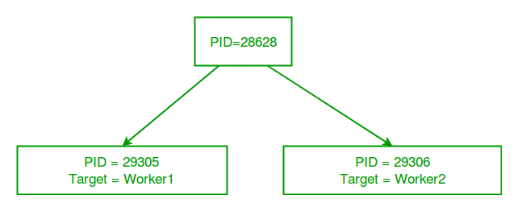
Multiprocessing in Python
The main python script has a different process ID and multiprocessing module spawns new processes with different process IDs as we create Process objects p1 and p2. In above program, we use os.getpid() function to get ID of process running the current target function.Notice that it matches with the process IDs of p1 and p2 which we obtain using pid attribute of Process class.
Each process runs independently and has its own memory space.
As soon as the execution of target function is finished, the processes get terminated. In above program we used is_alive method of Process class to check if a process is still active or not.
Consider the diagram below to understand how new processes are different from main Python script:

Slide 9
Communication between processes
Here we discuss the concept of data sharing and message passing between processes while using multiprocessing module in Python.
In multiprocessing, any newly created process will do following:
run independently
have their own memory space.
Consider the program below to understand this concept:
import multiprocessing
# empty list with global scope
result = []
def square_list(mylist):
"""
function to square a given list
"""
global result
# append squares of mylist to global list result
for num in mylist:
result.append(num * num)
# print global list result
print("Result(in process p1): {}".format(result))
if __name__ == "__main__":
# input list
mylist = [1,2,3,4]
# creating new process
p1 = multiprocessing.Process(target=square_list, args=(mylist,))
# starting process
p1.start()
# wait until process is finished
p1.join()
# print global result list
print("Result(in main program): {}".format(result))

Slide 10
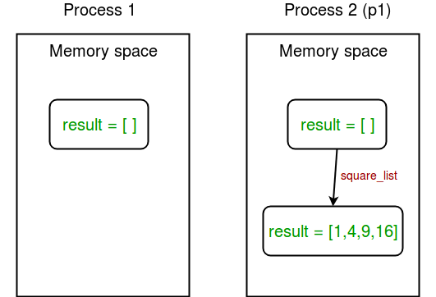
Communication between processes
In above example, we try to print contents of global list result at two places:
In square_list function. Since, this function is called by process p1, result list is changed in memory space of process p1 only.
After the completion of process p1 in main program. Since main program is run by a different process, its memory space still contains the empty result list.
Diagram shown below clears this concept:

Slide 11
Sharing data between processes
Shared memory : multiprocessing module provides Array and Value objects to share data between processes.Array: a ctypes array allocated from shared memory.
Value: a ctypes object allocated from shared memory.
Given below is a simple example showing use of Array and Value for sharing data between processes.
import multiprocessing
def square_list(mylist, result, square_sum):
"""
function to square a given list
"""
# append squares of mylist to result array
for idx, num in enumerate(mylist):
result[idx] = num * num
# square_sum value
square_sum.value = sum(result)
# print result Array
print("Result(in process p1): {}".format(result[:]))
# print square_sum Value
print("Sum of squares(in process p1): {}".format(square_sum.value))
if __name__ == "__main__":
# input list
mylist = [1,2,3,4]
# creating Array of int data type with space for 4 integers
result = multiprocessing.Array('i', 4)
# creating Value of int data type
square_sum = multiprocessing.Value('i')
# creating new process
p1 = multiprocessing.Process(target=square_list, args=(mylist, result, square_sum))
# starting process
p1.start()
# wait until the process is finished
p1.join()
# print result array
print("Result(in main program): {}".format(result[:]))
# print square_sum Value
print("Sum of squares(in main program): {}".format(square_sum.value))

Slide 12
Sharing data between processes
Let us try to understand the above code line by line:
First of all, we create an Array result like this:
result = multiprocessing.Array('i', 4)
First argument is the data type. ‘i’ stands for integer whereas ‘d’ stands for float data type.
Second argument is the size of array. Here, we create an array of 4 elements.
Similarly, we create a Value square_sum like this:
square_sum = multiprocessing.Value('i’)
Here, we only need to specify data type. The value can be given an initial value(say 10) like this:
square_sum = multiprocessing.Value('i', 10)
Secondly, we pass result and square_sum as arguments while creating Process object.
p1 = multiprocessing.Process(target=square_list, args=(mylist, result, square_sum))
result array elements are given a value by specifying index of array element.
for idx, num in enumerate(mylist):
result[idx] = num * num
square_sum is given a value by using its value attribute:
square_sum.value = sum(result)
In order to print result array elements, we use result[:] to print complete array.
print("Result(in process p1): {}".format(result[:]))
Value of square_sum is simply printed as:
print("Sum of squares(in process p1): {}".format(square_sum.value))

Slide 13
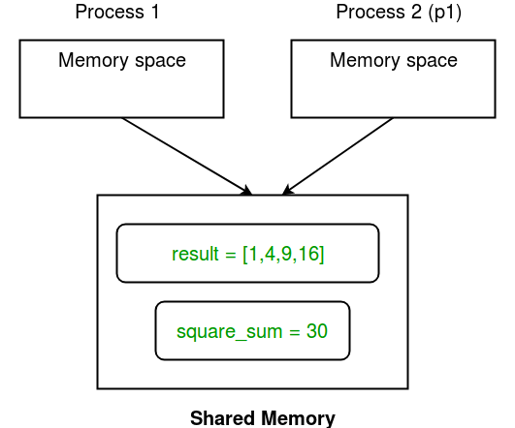
Sharing data between processes
Here is a diagram depicting how processes share Array and Value object:

Slide 14
Server process
Whenever a python program starts, a server process is also started. From there on, whenever a new process is needed, the parent process connects to the server and requests it to fork a new process.
A server process can hold Python objects and allows other processes to manipulate them using proxies.
multiprocessing module provides a Manager class which controls a server process. Hence, managers provide a way to create data that can be shared between different processes.
Server process managers are more flexible than using shared memory objects because they can be made to support arbitrary object types like lists, dictionaries, Queue, Value, Array, etc. Also, a single manager can be shared by processes on different computers over a network. They are, however, slower than using shared memory.

Slide 15
MULTITHREADING

Slide 16
Thread
In computing, a process is an instance of a computer program that is being executed. Any process has 3 basic components:
An executable program.
The associated data needed by the program (variables, work space, buffers, etc.)
The execution context of the program (State of process)
A thread is an entity within a process that can be scheduled for execution. Also, it is the smallest unit of processing that can be performed in an OS (Operating System).
In simple words, a thread is a sequence of such instructions within a program that can be executed independently of other code. For simplicity, you can assume that a thread is simply a subset of a process!
A thread contains all this information in a Thread Control Block (TCB):
Thread Identifier: Unique id (TID) is assigned to every new thread
Stack pointer: Points to thread’s stack in the process. Stack contains the local variables under thread’s scope.
Program counter: a register which stores the address of the instruction currently being executed by thread.
Thread state: can be running, ready, waiting, start or done.
Thread’s register set: registers assigned to thread for computations.
Parent process Pointer: A pointer to the Process control block (PCB) of the process that the thread lives on.

Slide 17
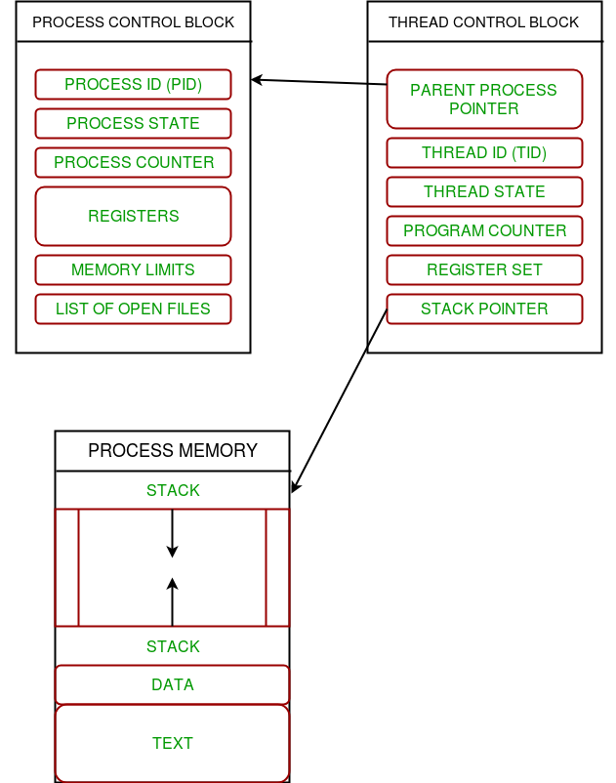
Thread
Consider the diagram below to understand the relation between process and its thread:

Slide 18
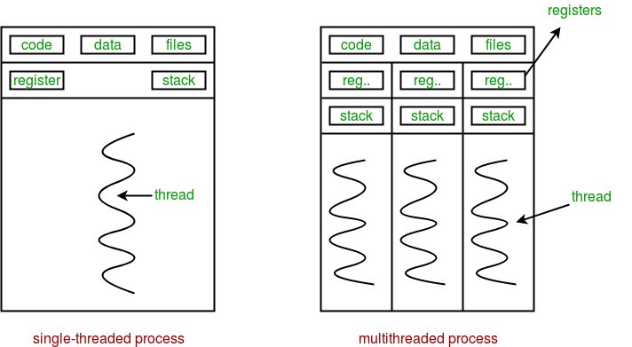
Multithreading
Multiple threads can exist within one process where:
Each thread contains its own register set and local variables (stored in stack).
All thread of a process share global variables (stored in heap) and the program code.
Consider the diagram below to understand how multiple threads exist in memory:

Slide 19
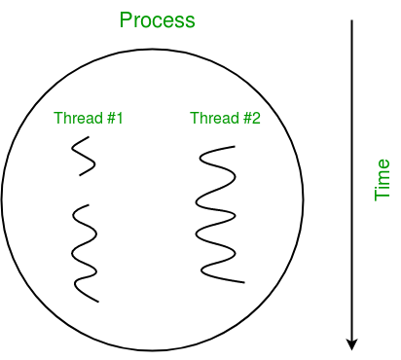
Multithreading
Multithreading is defined as the ability of a processor to execute multiple threads concurrently.
In a simple, single-core CPU, it is achieved using frequent switching between threads. This is termed as context switching. In context switching, the state of a thread is saved and state of another thread is loaded whenever any interrupt (due to I/O or manually set) takes place. Context switching takes place so frequently that all the threads appear to be running parallelly (this is termed as multitasking).
Consider the diagram below in which a process contains two active threads:

Slide 20
Multithreading in Python
In Python, the threading module provides a very simple and intuitive API for spawning multiple threads in a program.
Let us consider a simple example using threading module:
# importing the threading module
import threading
def print_cube(num):
"""
function to print cube of given num
"""
print("Cube: {}".format(num * num * num))
def print_square(num):
"""
function to print square of given num
"""
print("Square: {}".format(num * num))
if __name__ == "__main__":
# creating thread
t1 = threading.Thread(target=print_square, args=(10,))
t2 = threading.Thread(target=print_cube, args=(10,))
# starting thread 1
t1.start()
# starting thread 2
t2.start()
# wait until thread 1 is completely executed
t1.join()
# wait until thread 2 is completely executed
t2.join()
# both threads completely executed
print("Done!")

Slide 21
Multithreading in Python
Let us try to understand the above code:
To import the threading module, we do:
import threading
To create a new thread, we create an object of Thread class. It takes following arguments:
target: the function to be executed by thread
args: the arguments to be passed to the target function
In above example, we created 2 threads with different target functions:
t1 = threading.Thread(target=print_square, args=(10,))
t2 = threading.Thread(target=print_cube, args=(10,))
To start a thread, we use start method of Thread class.
t1.start()
t2.start()
Once the threads start, the current program (you can think of it like a main thread) also keeps on executing. In order to stop execution of current program until a thread is complete, we use join method.
t1.join() As a result, the current program will first wait for the completion of t1 and then t2. Once, they are finished, the remaining statements of current program are executed.
t2.join()
As a result, the current program will first wait for the completion of t1 and then t2. Once, they are finished, the remaining statements of current program are executed.

Slide 22
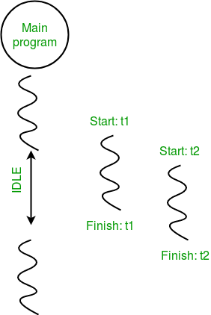
Multithreading in Python
Consider the diagram below for a better understanding of how above program works:

Slide 23
Multithreading in Python
Consider the python program given below in which we print thread name and corresponding process for each task:
import threading
import os
def task1():
print("Task 1 assigned to thread: {}".format(threading.current_thread().name))
print("ID of process running task 1: {}".format(os.getpid()))
def task2():
print("Task 2 assigned to thread: {}".format(threading.current_thread().name))
print("ID of process running task 2: {}".format(os.getpid()))
if __name__ == "__main__":
# print ID of current process
print("ID of process running main program: {}".format(os.getpid()))
# print name of main thread
print("Main thread name: {}".format(threading.current_thread().name))
# creating threads
t1 = threading.Thread(target=task1, name='t1')
t2 = threading.Thread(target=task2, name='t2')
# starting threads
t1.start()
t2.start()
# wait until all threads finish
t1.join()
t2.join()

Slide 24
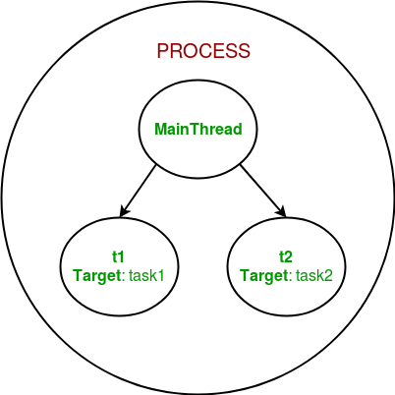
Multithreading in Python
Let us try to understand the above code:
We use os.getpid() function to get ID of current process.
print("ID of process running main program: {}".format(os.getpid()))
As it is clear from the output, the process ID remains same for all threads.
We use threading.main_thread() function to get the main thread object. In normal conditions, the main thread is the thread from which the Python interpreter was started. name attribute of thread object is used to get the name of thread.
print("Main thread name: {}".format(threading.main_thread().name))
We use the threading.current_thread() function to get the current thread object.
print("Task 1 assigned to thread: {}".format(threading.current_thread().name))
The diagram given below clears the above concept:

Slide 25
SYNCHRONIZATION

Slide 26
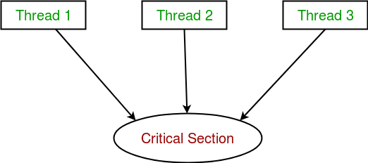
Synchronization between threads
Thread synchronization is defined as a mechanism which ensures that two or more concurrent threads do not simultaneously execute some particular program segment known as critical section.
Critical section refers to the parts of the program where the shared resource is accessed.
For example, in the diagram below, 3 threads try to access shared resource or critical section at the same time.
Concurrent accesses to shared resource can lead to race condition.
A race condition occurs when two or more threads can access shared data and they try to change it at the same time. As a result, the values of variables may be unpredictable and vary depending on the timings of context switches of the processes.

Slide 27
RACE CONDITION
Consider the program below to understand the concept of race condition:
import threading
# global variable x
x = 0
def increment():
"""
function to increment global variable x
"""
global x
x += 1
def thread_task():
"""
task for thread
calls increment function 100000 times.
"""
for _ in range(100000):
increment()
def main_task():
global x
# setting global variable x as 0
x = 0
# creating threads
t1 = threading.Thread(target=thread_task)
t2 = threading.Thread(target=thread_task)
# start threads
t1.start()
t2.start()
# wait until threads finish their job
t1.join()
t2.join()
if __name__ == "__main__":
for i in range(10):
main_task()
print("Iteration {0}: x = {1}".format(i,x))

Slide 28
RACE CONDITION
In above program:
Two threads t1 and t2 are created in main_task function and global variable x is set to 0.
Each thread has a target function thread_task in which increment function is called 100000 times.
increment function will increment the global variable x by 1 in each call.
The expected final value of x is 200000 but what we get in 10 iterations of main_task function is some different values.
This happens due to concurrent access of threads to the shared variable x. This unpredictability in value of x is nothing but race condition.

Slide 29
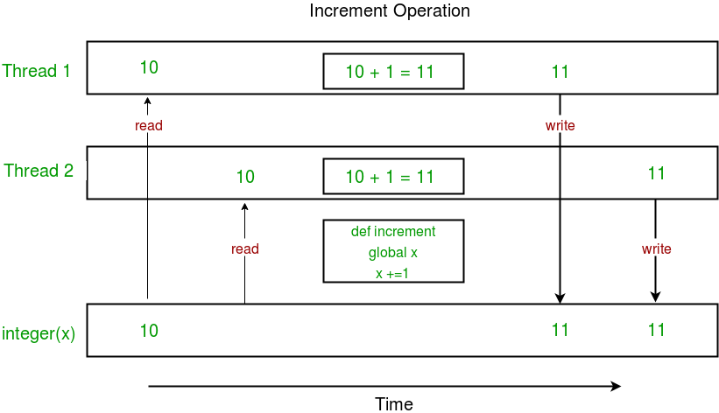
RACE CONDITION
Given below is a diagram which shows how can race condition occur in above program:
Notice that expected value of x in above diagram is 12 but due to race condition, it turns out to be 11.
Hence, we need a tool for proper synchronization between multiple threads.

Slide 30
LOCKS
threading module provides a Lock class to deal with the race conditions. Lock is implemented using a Semaphore object provided by the Operating System.
A semaphore is a synchronization object that controls access by multiple processes/threads to a common resource in a parallel programming environment. It is simply a value in a designated place in operating system (or kernel) storage that each process/thread can check and then change. Depending on the value that is found, the process/thread can use the resource or will find that it is already in use and must wait for some period before trying again. Semaphores can be binary (0 or 1) or can have additional values. Typically, a process/thread using semaphores checks the value and then, if it using the resource, changes the value to reflect this so that subsequent semaphore users will know to wait.
Lock class provides following methods:
acquire([blocking]) : To acquire a lock. A lock can be blocking or non-blocking.
When invoked with the blocking argument set to True (the default), thread execution is blocked until the lock is unlocked, then lock is set to locked and return True.
When invoked with the blocking argument set to False, thread execution is not blocked. If lock is unlocked, then set it to locked and return True else return False immediately.
release() : To release a lock.
When the lock is locked, reset it to unlocked, and return. If any other threads are blocked waiting for the lock to become unlocked, allow exactly one of them to proceed.
If lock is already unlocked, a ThreadError is raised.

Slide 31
USING LOCKS
Consider the example given below:
import threading
# global variable x
x = 0
def increment():
global x
x += 1
def thread_task(lock):
for _ in range(100000):
lock.acquire()
increment()
lock.release()
def main_task():
global x
# setting global variable x as 0
x = 0
# creating a lock
lock = threading.Lock()
# creating threads
t1 = threading.Thread(target=thread_task, args=(lock,))
t2 = threading.Thread(target=thread_task, args=(lock,))
# start threads
t1.start()
t2.start()
# wait until threads finish their job
t1.join()
t2.join()
if __name__ == "__main__":
for i in range(10):
main_task()
print("Iteration {0}: x = {1}".format(i,x))

Slide 32
USING LOCKS
Let us try to understand the above code step by step:
Firstly, a Lock object is created using:
lock = threading.Lock()
Then, lock is passed as target function argument:
t1 = threading.Thread(target=thread_task, args=(lock,))
t2 = threading.Thread(target=thread_task, args=(lock,))
In the critical section of target function, we apply lock using lock.acquire() method. As soon as a lock is acquired, no other thread can access the critical section (here, increment function) until the lock is released using lock.release() method.
lock.acquire()
increment()
lock.release()
As you can see in the results, the final value of x comes out to be 200000 every time (which is the expected final result).

Slide 33
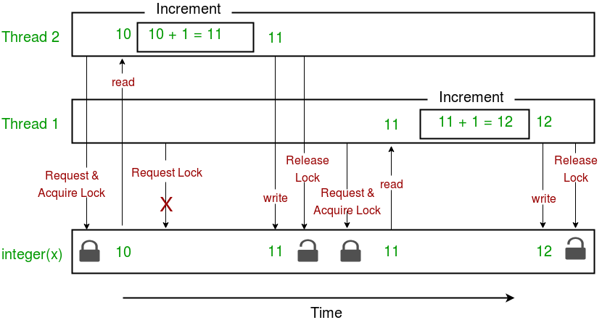
USING LOCKS
Here is a diagram given below which depicts the implementation of locks in above program:

Slide 34
MULTITHREADING ADVANTAGES & DISADVANTAGES
Advantages:
It doesn’t block the user. This is because threads are independent of each other.
Better use of system resources is possible since threads execute tasks parallely.
Enhanced performance on multi-processor machines.
Multi-threaded servers and interactive GUIs use multithreading exclusively.
Disadvantages:
As number of threads increase, complexity increases.
Synchronization of shared resources (objects, data) is necessary.
It is difficult to debug, result is sometimes unpredictable.
Potential deadlocks which leads to starvation, i.e. some threads may not be served with a bad design
Constructing and synchronizing threads is CPU/memory intensive.

